Slide 1
Building a Story: The Basics
By Nicole Manley

Slide 2

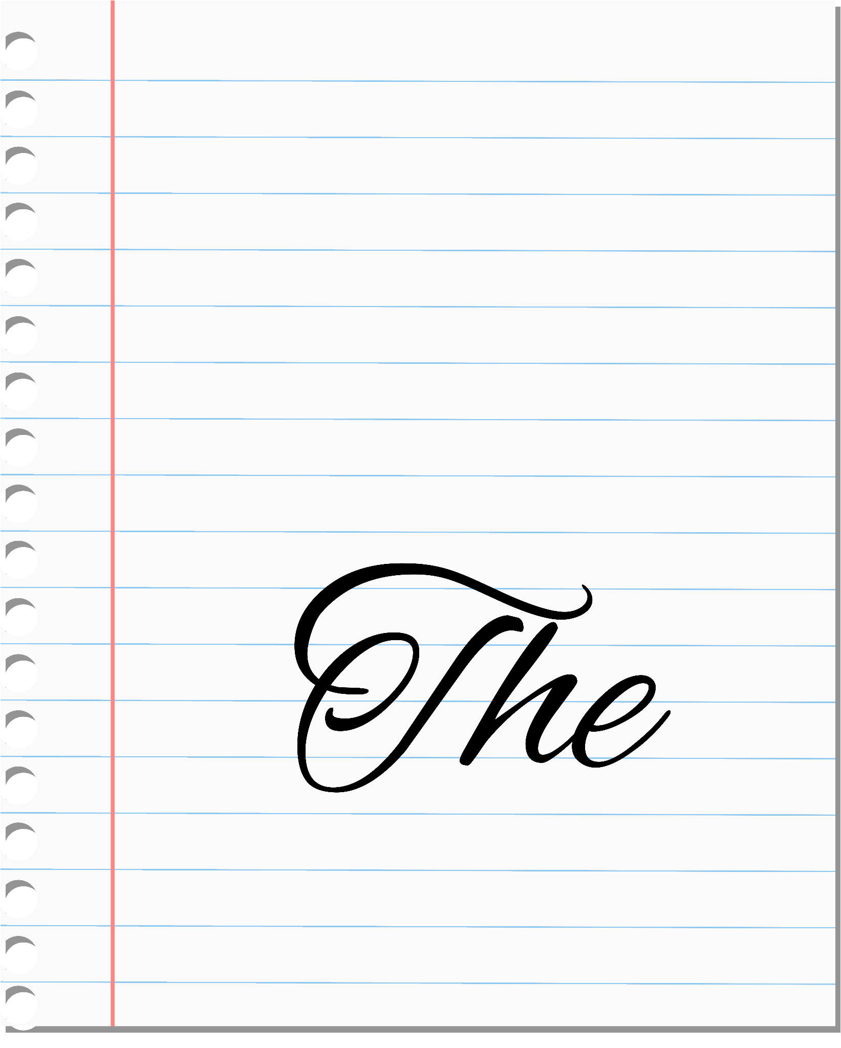
Scene #1
Extreme close-up shots up of a pen moving across a paper in different directions. It ultimately switches a regular close-up to show a big fancy “The,” like the iconic none in Spongebob.
Script: “Have you ever had a really cool story idea, complete with dragons and Gregorian choirs in your mind, but you just aren’t sure how to get it on paper?”
Background music: Light, airy.

Slide 3

Scene #2
Medium close-up shot of me sitting at an “interview” table with the back of an open laptop to the side.
Script: “Today, I’m gonna funnel what I’ve learned from my writing minor and research and try to break the fundamentals of story creation into simple suggestions about plot structure, character creation, and worldbuilding.”
Background music: Light, airy. Quieter now.

Slide 4

Scene #3
Moving establishing shot, first-person perspective moving through a library aisle. Switches to panning shots of various bookshelves.
Script: “Now, while I’m going to explain these concepts in straightforward terms, it’s best to read widely, because you’ll learn to recognize patterns.”
Background music: Light, airy.

Slide 5
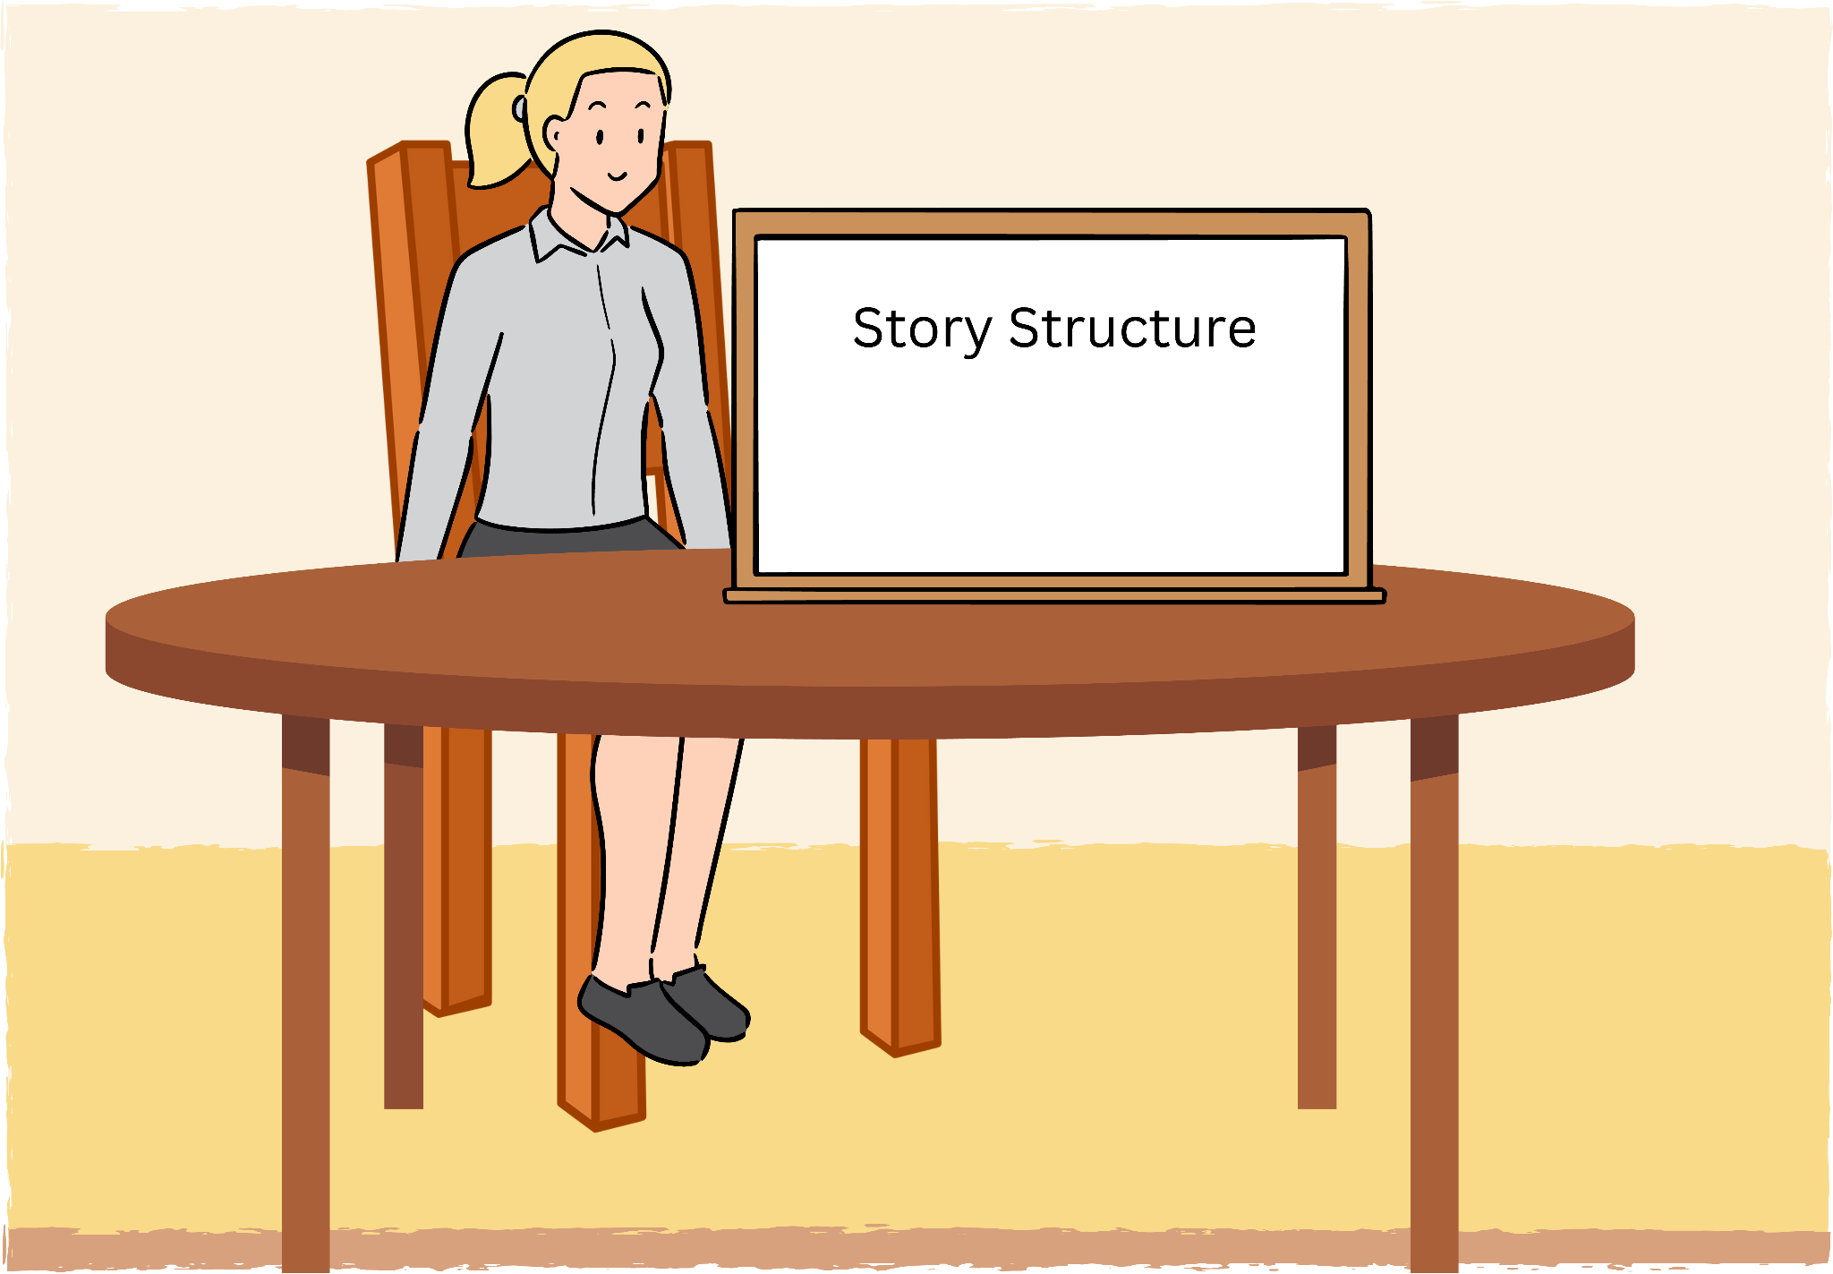
Scene #4
Medium close-up shot of me sitting next to a whiteboard with the words “Story Structure” next to me.
Script: “First off, I’m going to explain some of the most common plot structures and terminology.”
Background music: Shifts into a more quiet, contemplative song.

Slide 6
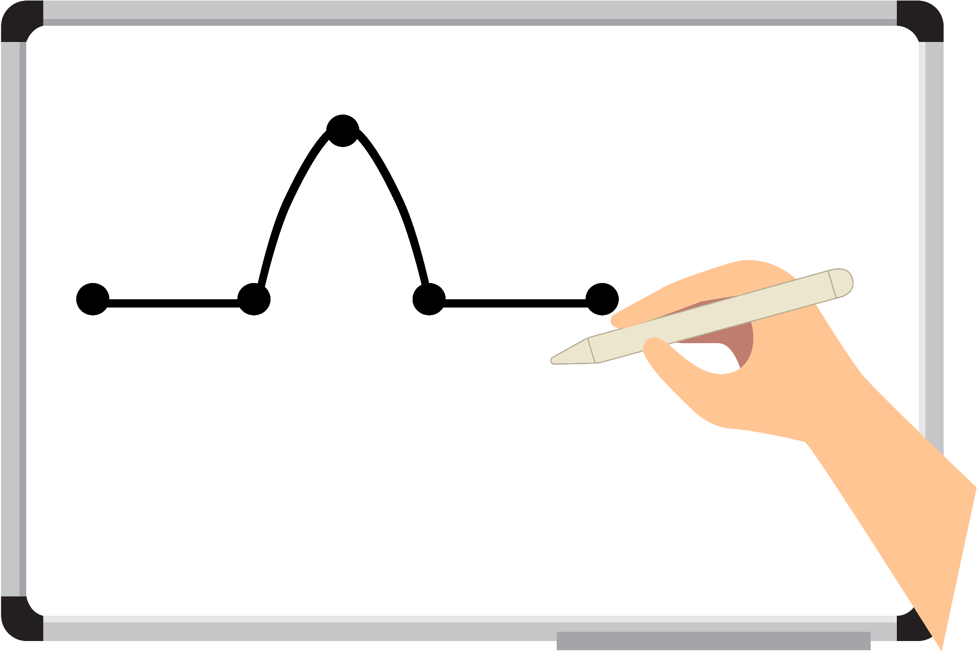
Scene #5
Big close-up shot of my hand drawing across the whiteboard, drawing the most classic novel structure. Switches to different angles.
Script: “So, there are a ton of different amazing story structures spread across different cultures. But here, I’m starting off with the classic novel structure we’re all probably the most familiar with. I’m going to use Harry Potter and the Sorcerer's Stone as a great example of this. These plot points can easily be divided into three main acts.”
Background music: Continues with a more quiet, contemplative song.

Slide 7
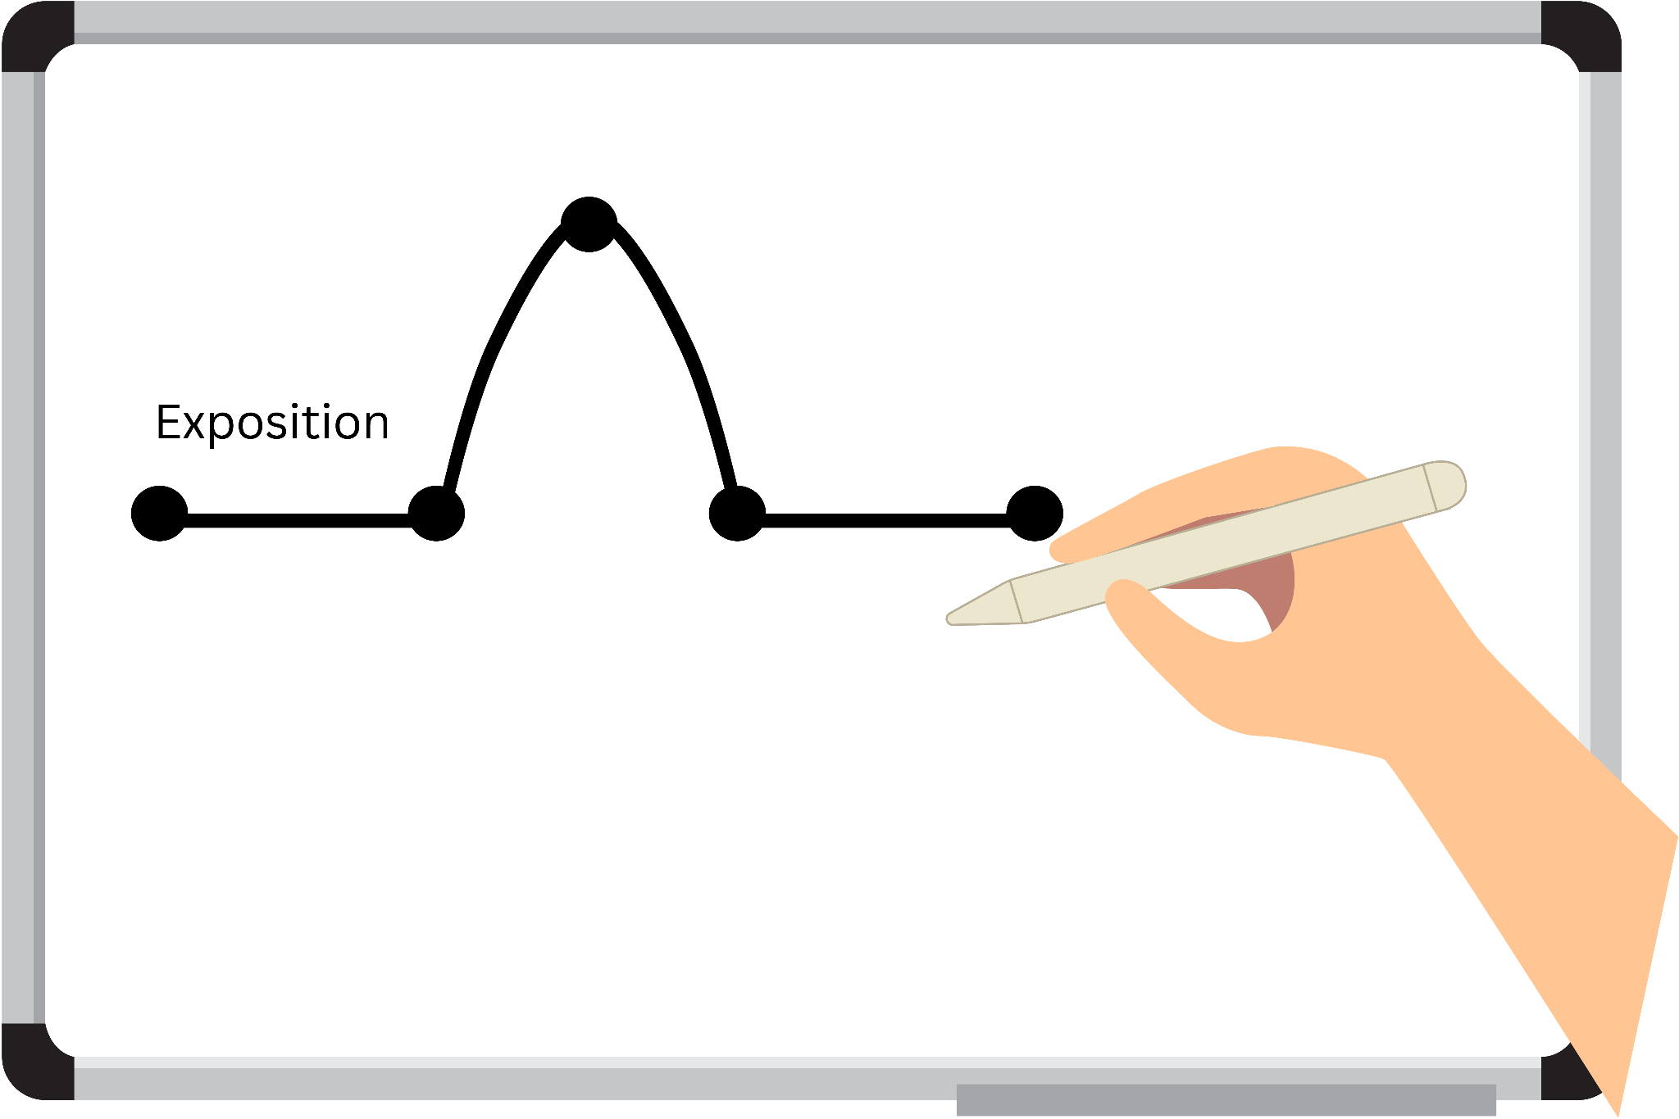
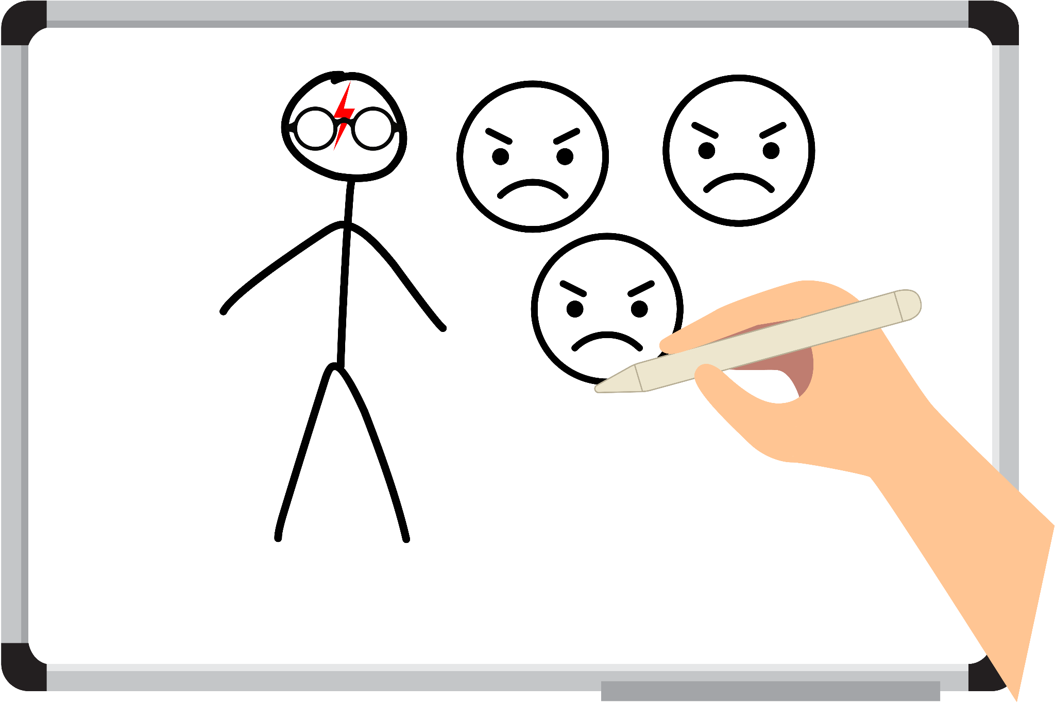
Scene #6
Close-up of my hand writing “Exposition” on the diagram. Then switches to another angle of my hand drawing Harry with a sad face, surrounded by angry faces.
Script: “Exposition is the first part of a story. This introduces the main character (and important side ones, possibly) and their background, the story setting and time, potential conflicts, and so on. It’s the normal life that’s about to change. This is the time where Harry lives in the cupboard under the stairs with his terrible, boring relatives.”
Background music: Continues in the more quiet, contemplative song.

Slide 8

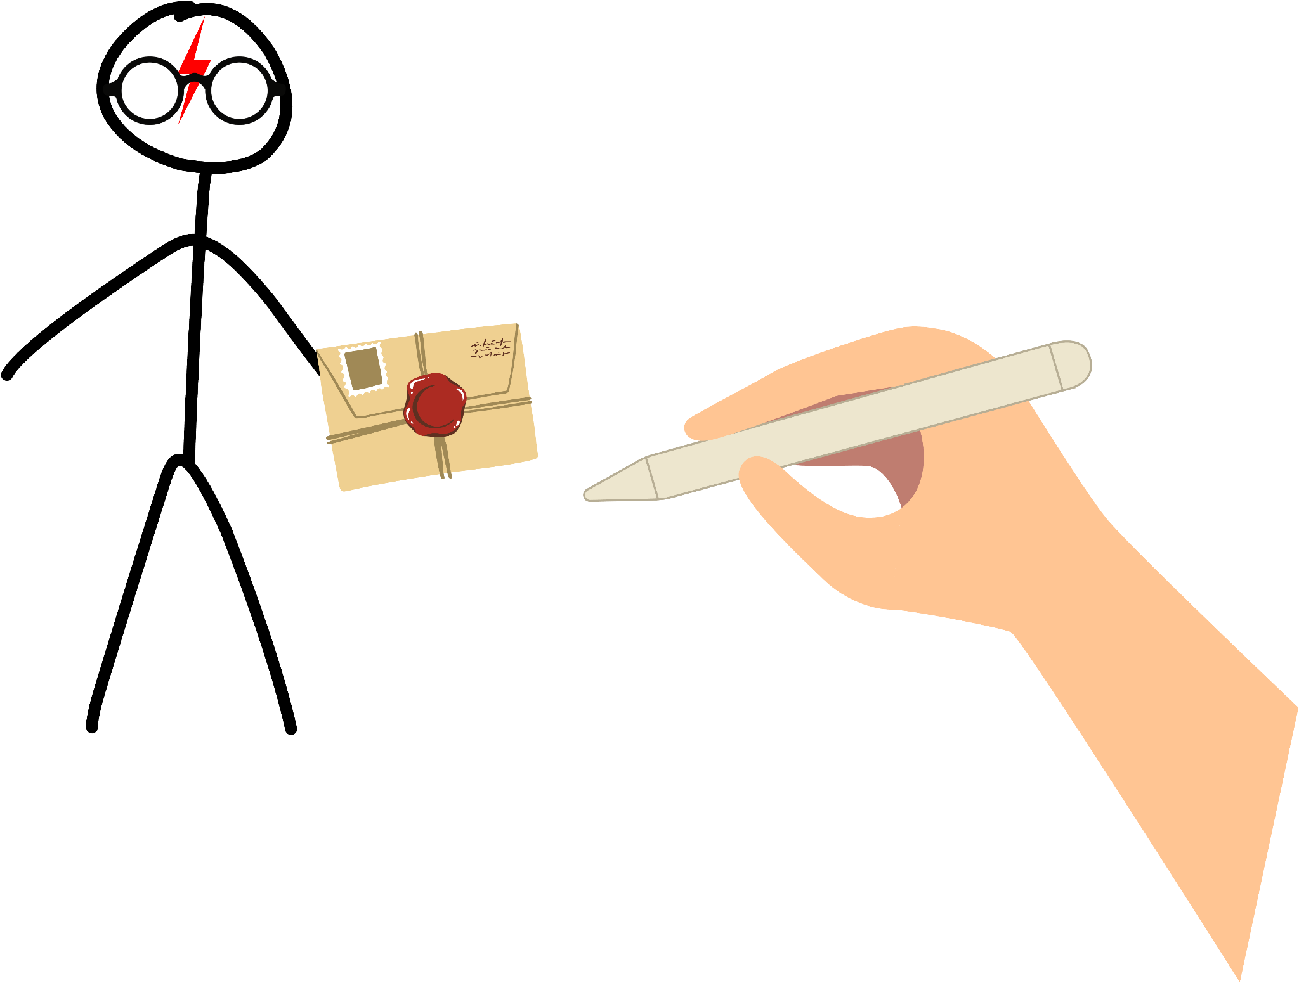
Scene #7
Close-up of my hand writing “Inciting Incident” on the diagram. Transitions to myself drawing pictures of Harry with his letter.
Script: “Inciting Incident is the part of the story where the plot kicks in. Something out of the norm happens, signaling a call to adventure, establishing a new goal, developing a new conflict–things like that! This is where Harry gets his first Hogwarts letter and his relatives begin to freak out and hide them, even going as far to relocate.”
Background music: Background music gets a little more intense.

Slide 9
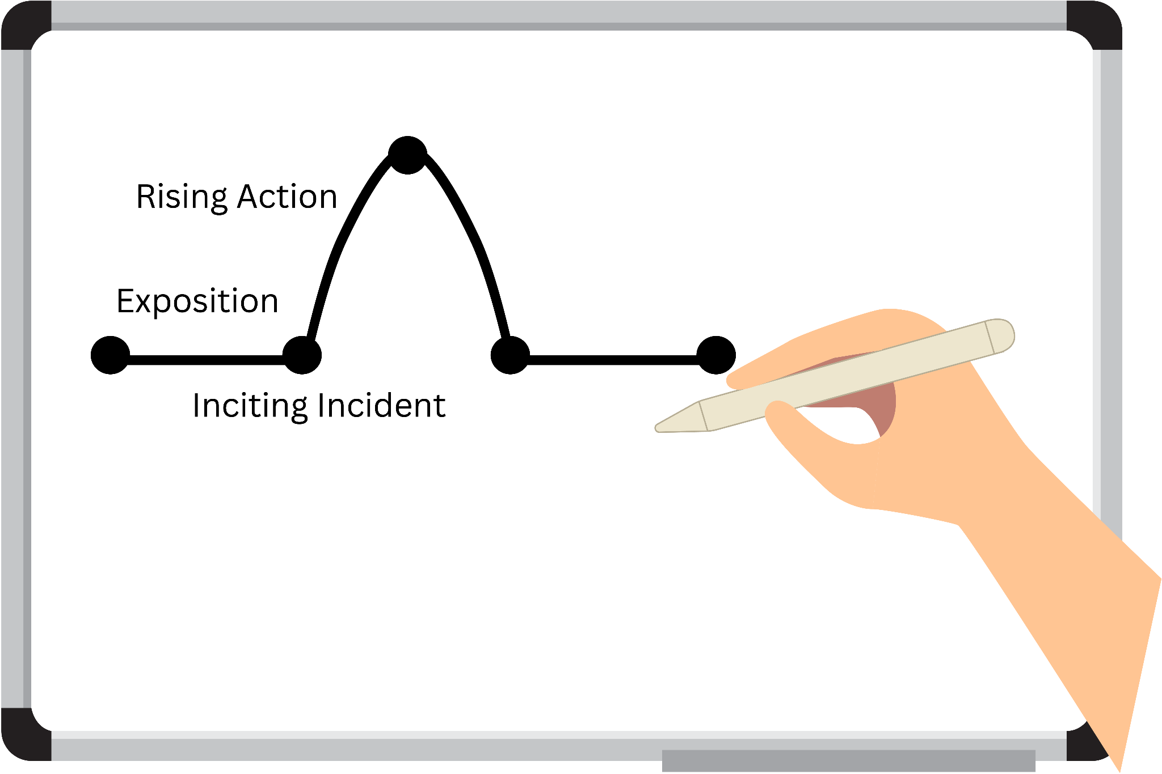
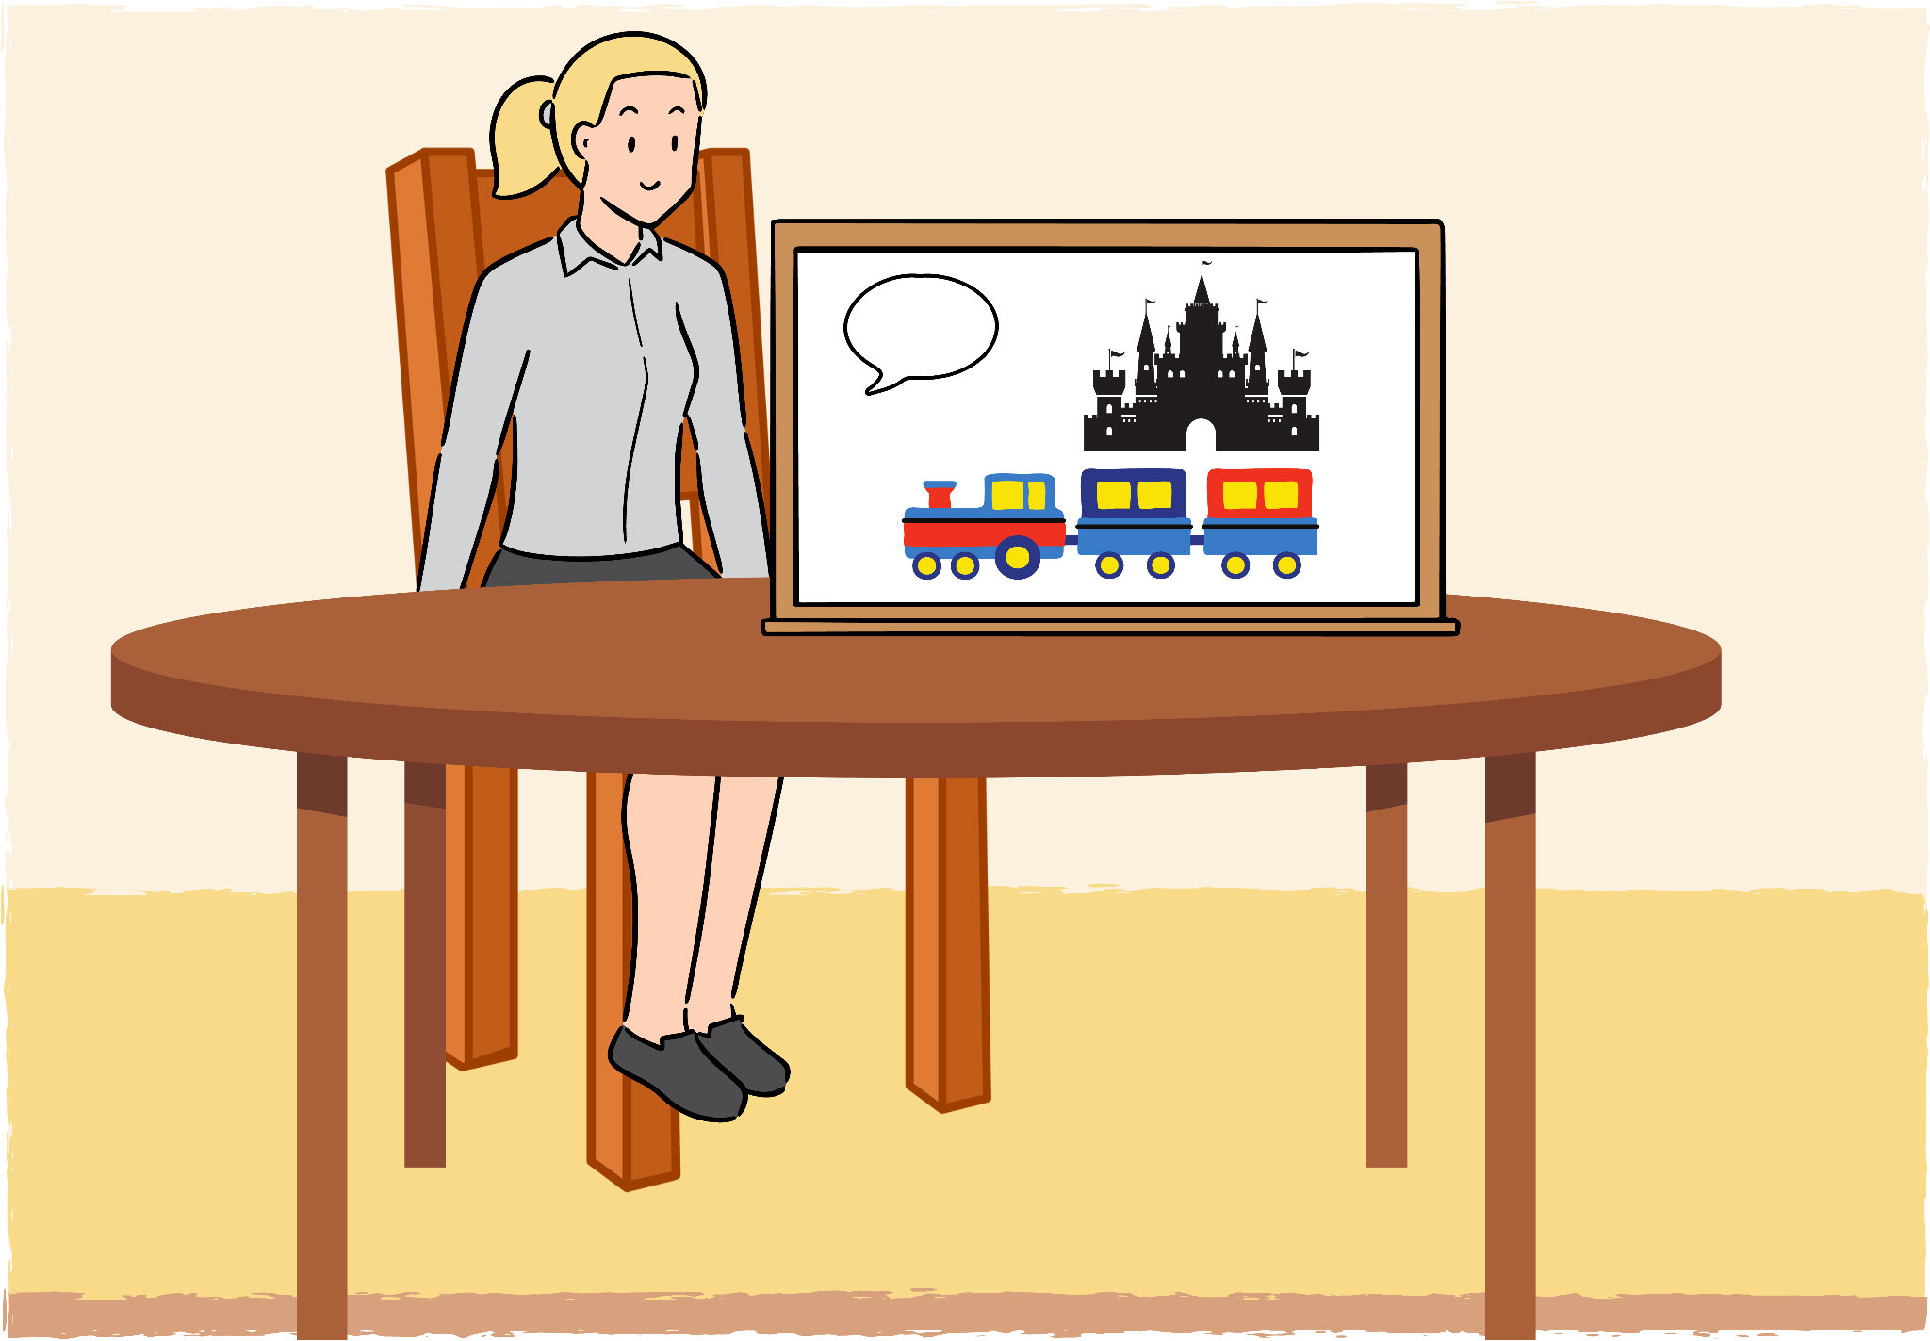
Scene #8
Close-up of my hand writing “Rising Action” on the diagram. Transitions to a medium-shot of myself holding the whiteboard, with pictures of a dialogue box, a train, and a castle. I point to each as I discuss the elements.
Script: “Rising Action builds up to the main climax. With each big plot point, tension increases, mysteries deepen, conflicts grow, etc. This is where Harry learns he’s a wizard and that an evil man named Voldemort killed his parents, he and Hagrid take a mysterious package from Gringotts, he meets the Weasleys, and arrives to Hogwarts. Act 1 roughly ends where he arrives at the castle, because his world and setting has entirely shifted.”
Background music: Background music continues in intensity.

Slide 10

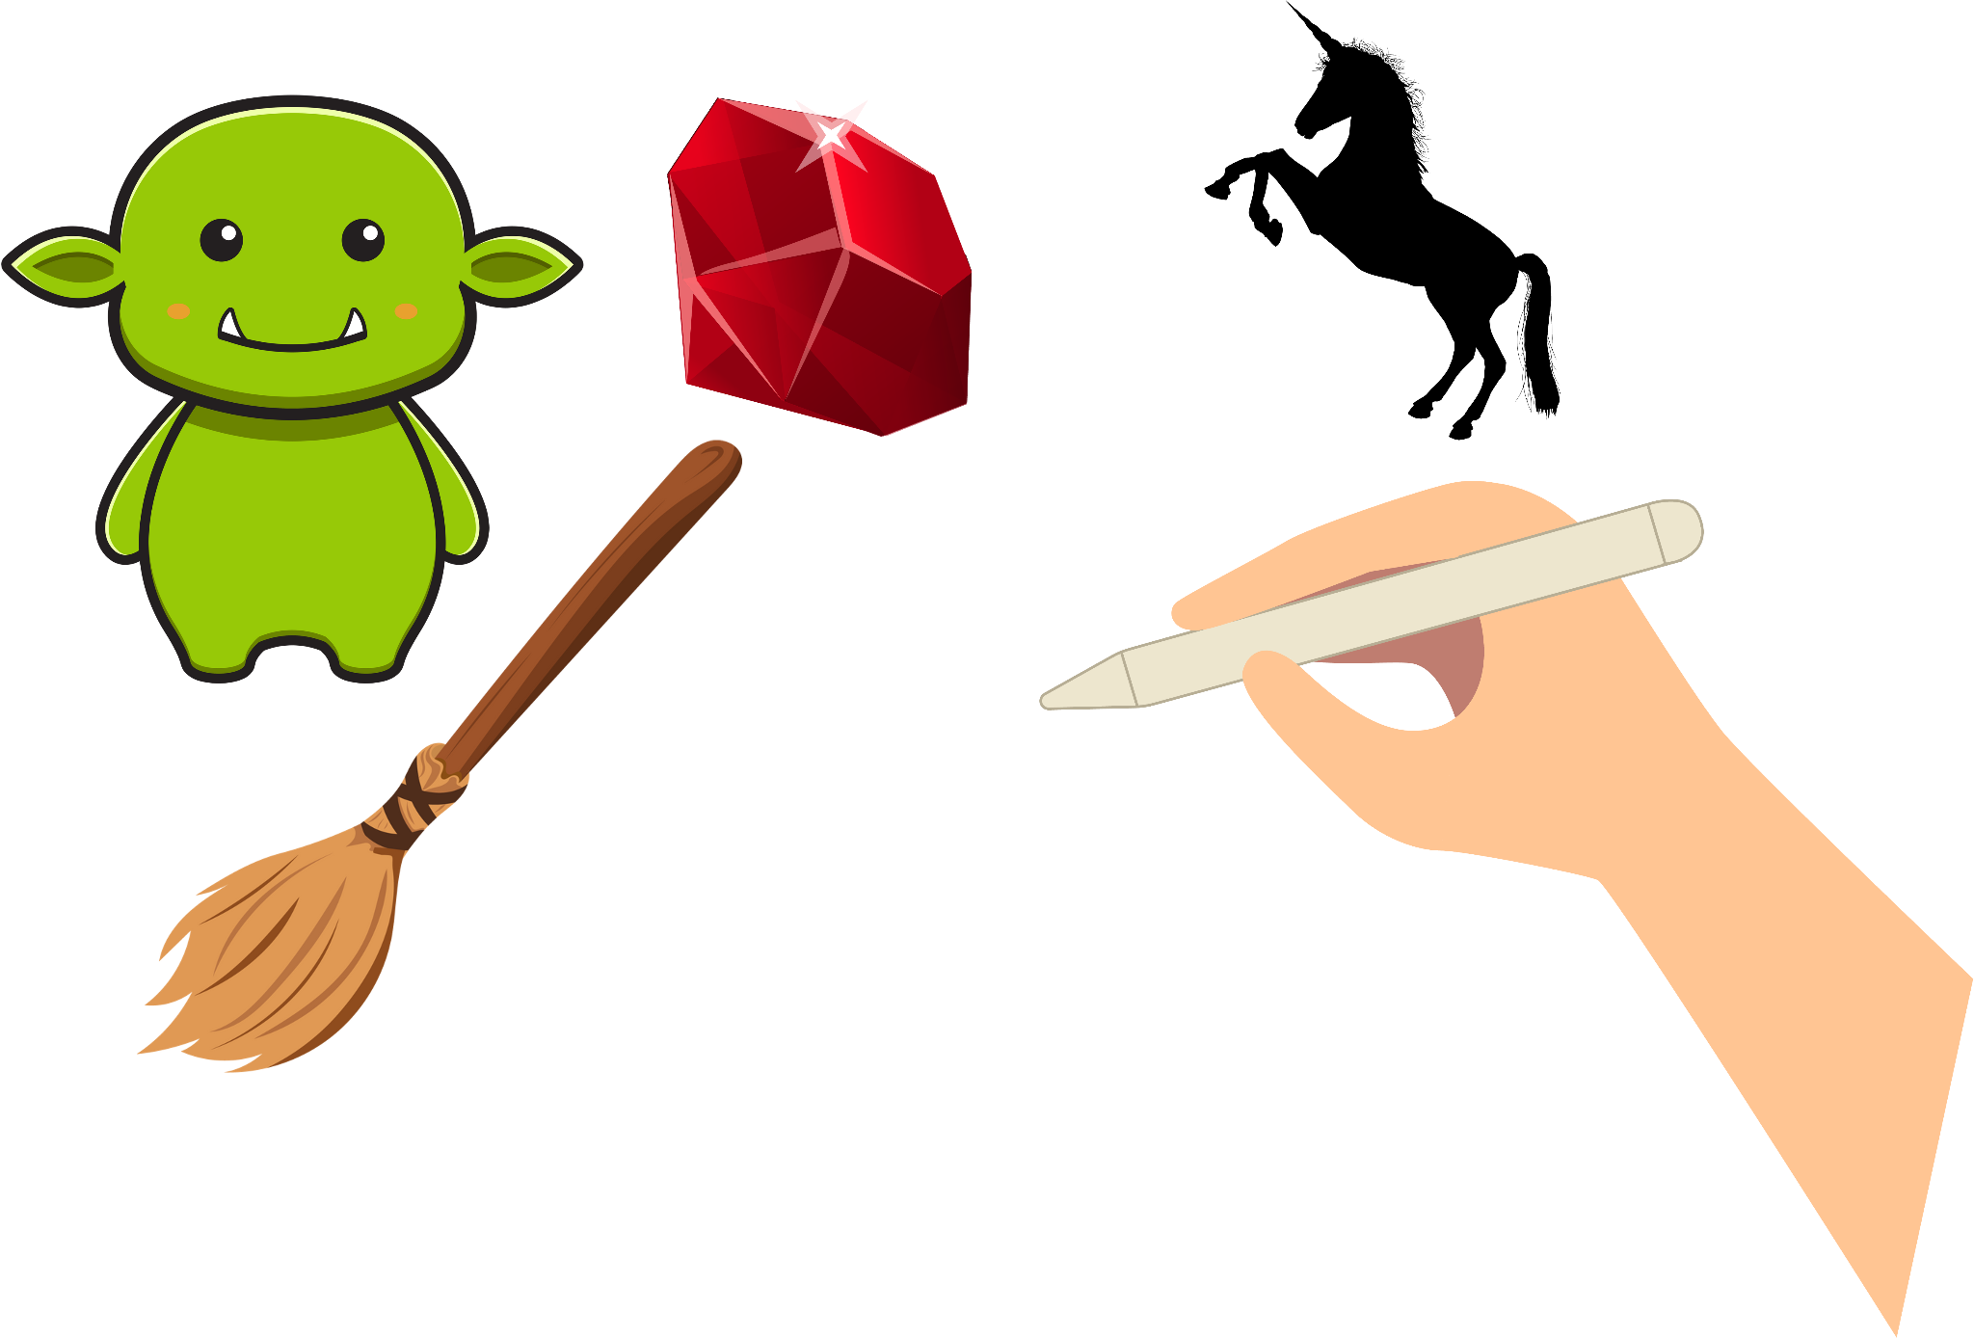
Scene #9
Close-up of my hand pinching a fidget toy. Transitions to a close-up of my hand drawing a troll, a stone, a broomstick, and a unicorn.
Script: “Now, littered throughout this Rising Action are pinch points, which are moments that intensify the stakes and usually challenge the protagonist in a way that involves introducing and utilizing the antagonist. For example, Harry and Ron defeat a mountain troll to save Hermione and deduce that Snape visited the forbidden third floor. These pinch points often occur around a midpoint, some sort of twist in plot or shift in tone, like when Harry figures out that the Sorcerer’s Stone is in the third floor corridor and Snape must be after it. Then, Harry is almost thrown off his broom in his first Quidditch Match, presumably by Snape, and later in the book he stumbles upon a dark, hooded figure feeding on a dead unicorn: Voldemort. This pushes Harry to figure out a way to stop this enemy and save himself.”
Background music: Background music increases in intensity.

Slide 11
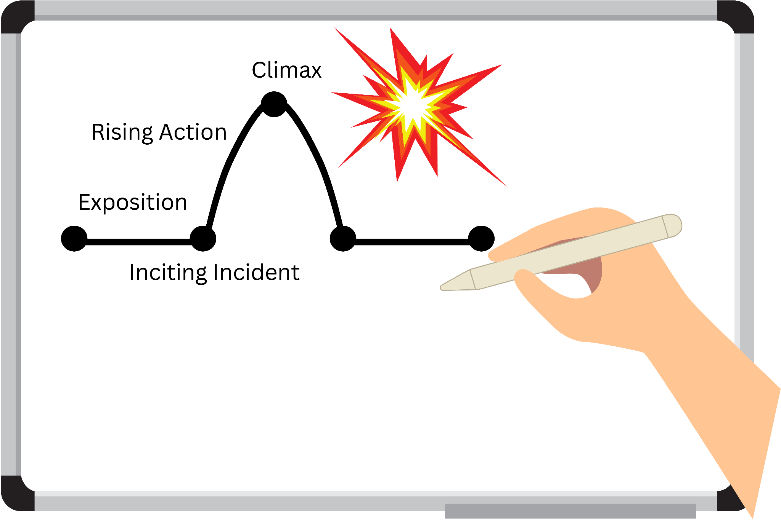
Scene #10
Close-up of my hand writing “Climax” on the diagram. Little animation of an explosion.
Script: “The climax is the most dramatic and arguably important section of a book. Plots and subplots converge, characters arcs reach their potential, the action is at its peak, the themes and emotions are all heightened. Whatever plot you’ve written up to this point, it must pay off in a satisfactory way. This is in the Act 3 of Sorcerer’s Stone (which starts when Harry and his friends confront the three-headed dog in the forbidden corridor, culminating with Harry discovering that Professor Quirrell is the real enemy and possesses Voldemort in the back of his head, and Harry fights to protect the Sorcerer’s Stone.”
Background music: Background music is at its most intense.

Slide 12
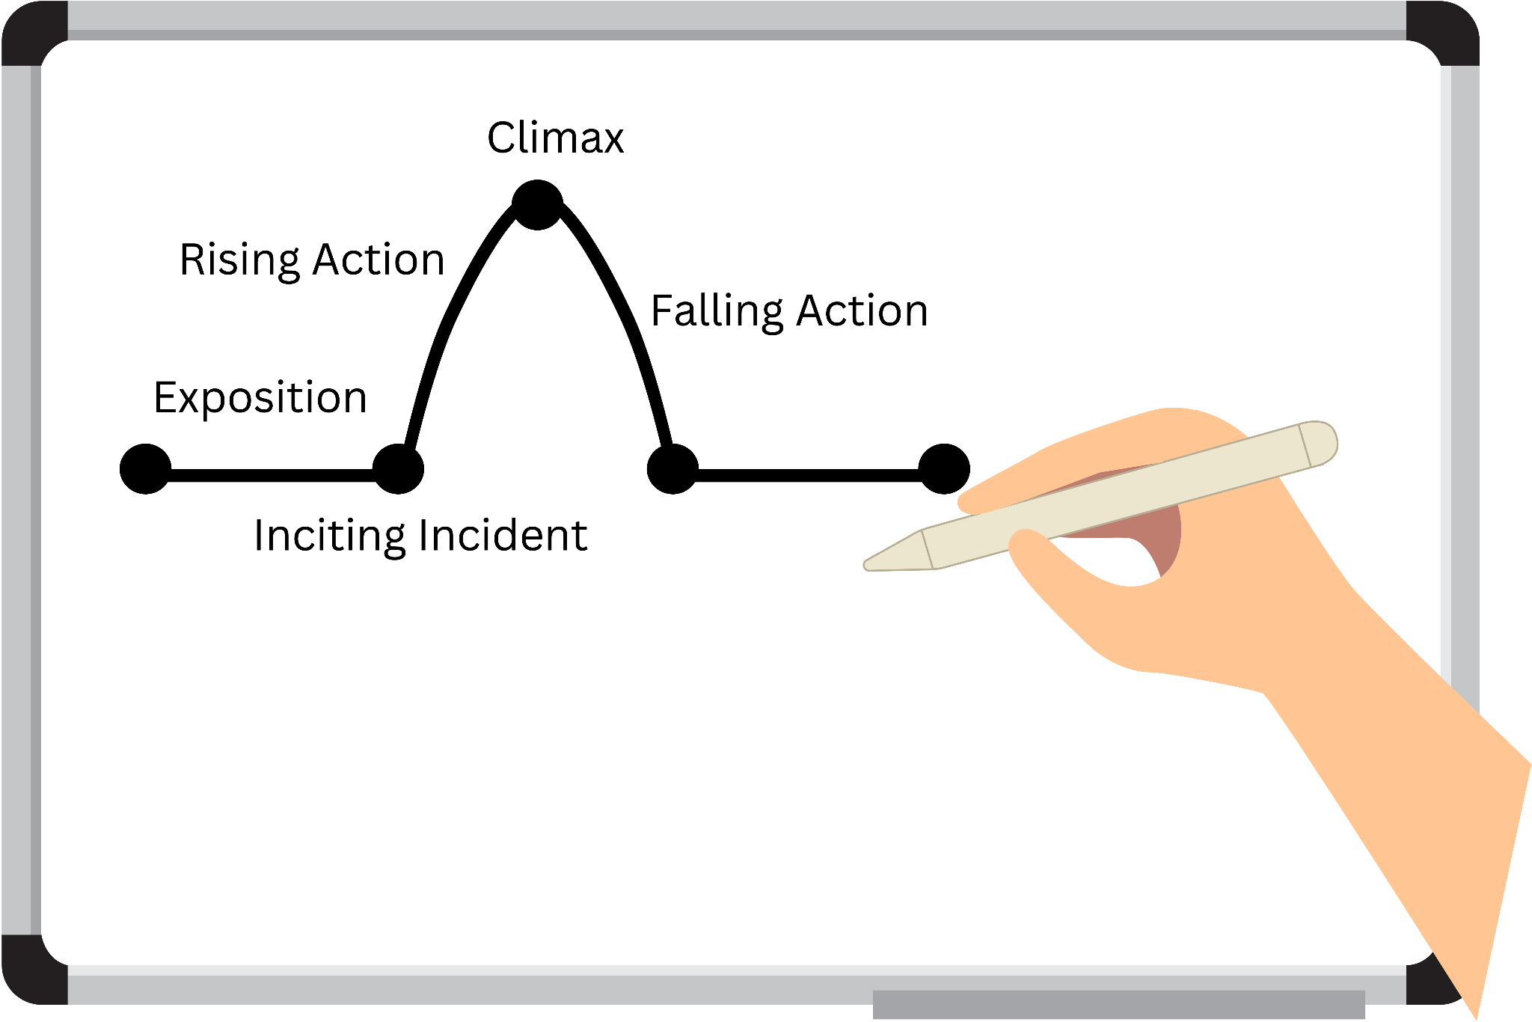
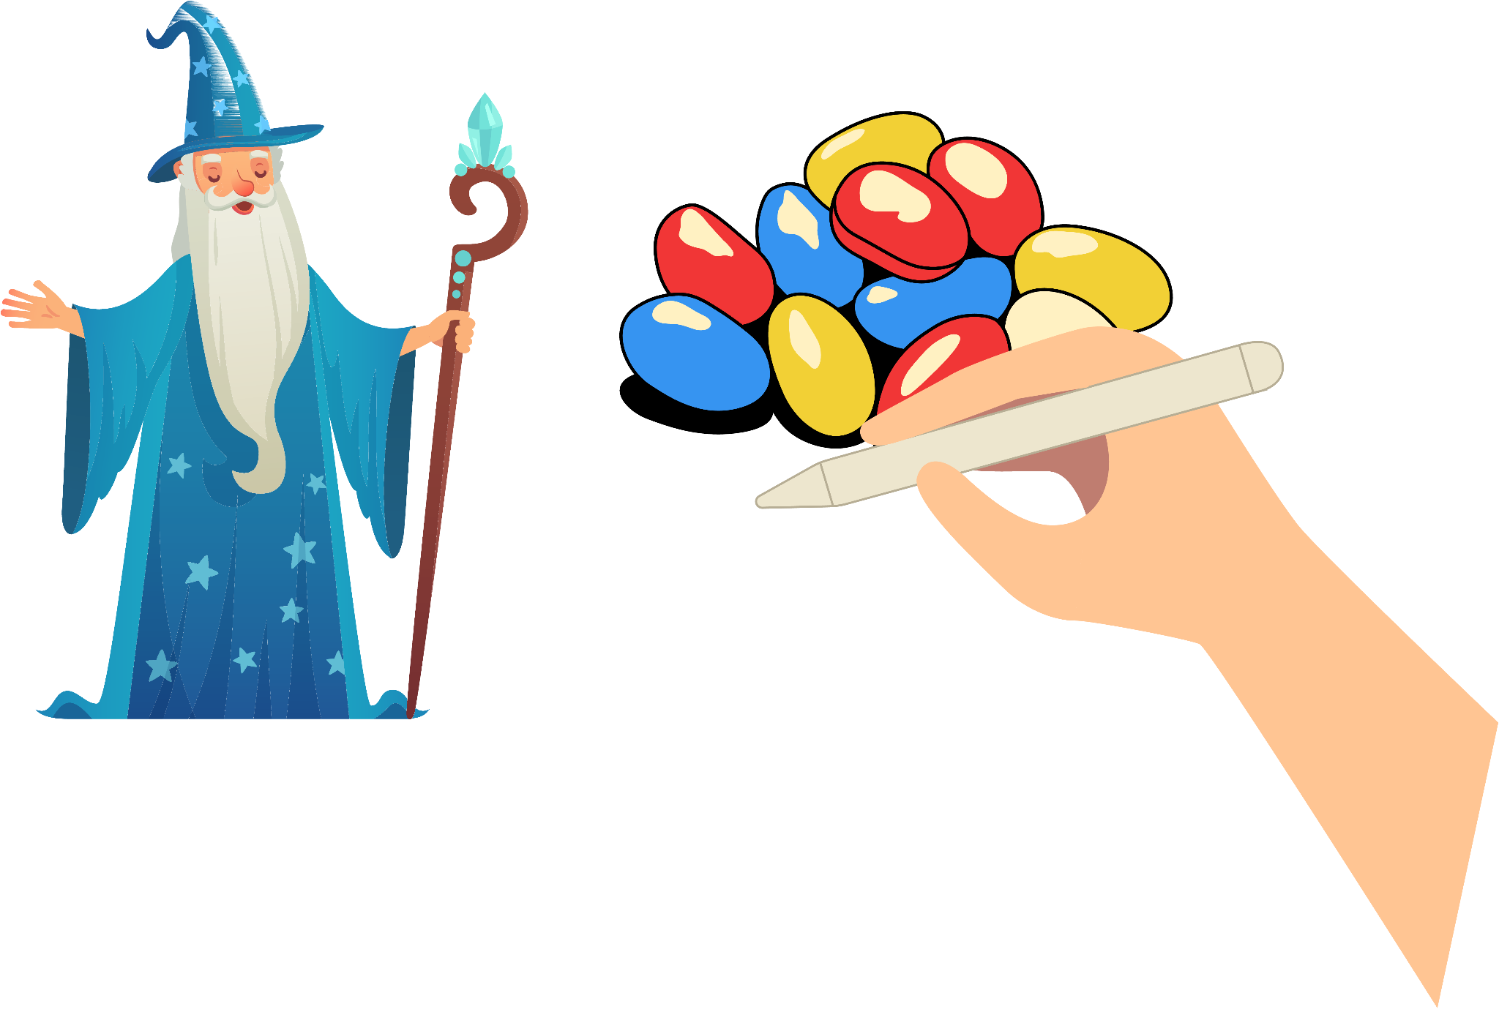
Scene #9
Close-up of my hand writing “Falling Action” on the diagram. Transitions to my hand drawing a picture of Dumbledore’s head and a pile of jelly beans.
Script: “The Falling Action illustrate the consequences of the climax. What did the characters win, lose, learn? How did they grow? What happens next? The story is winding down. Harry wakes up in a hospital bed with Headmaster Dumbledore visiting him, explaining that Quirrell is dead, the Sorcerer’s Stone will be destroyed, and Harry has a unique protection against Voldemort that occurred due to love, when his mother sacrificed her life for him.”
Background music: Background music softens and turns sweeter.

Slide 13
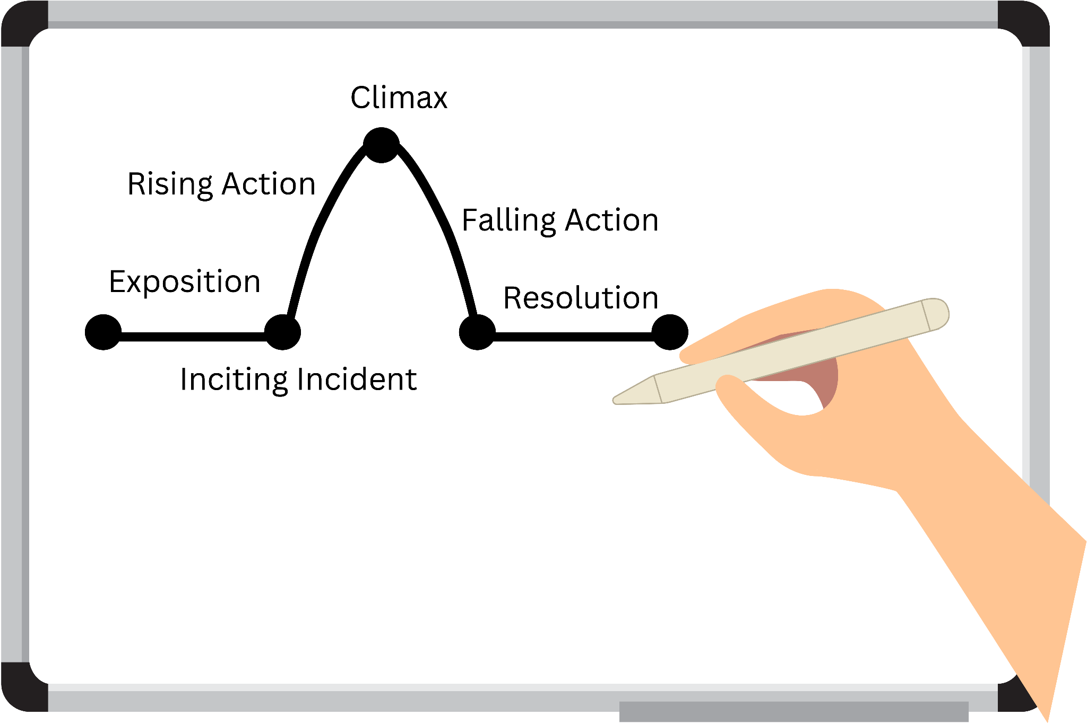

Scene #10
Close-up of my hand writing “Resolution” on the diagram. Transitions to my hand drawing a train.
Script: “The Resolution wraps all, or most, remaining plot threads. Questions are answered, character arcs complete, and the journey ends. Now, if this is a book in a series, then there can still be some plot threads dangling for future use or incomplete arcs, but be careful with this, because while cliffhangers are fun, they can feel cheap over time. Harry retakes the Hogwarts train to return to his relatives, but not before receiving a photobook of his parents and acknowledging that Hogwarts is his new home.”
Background music: Background music continues softly.

Slide 14
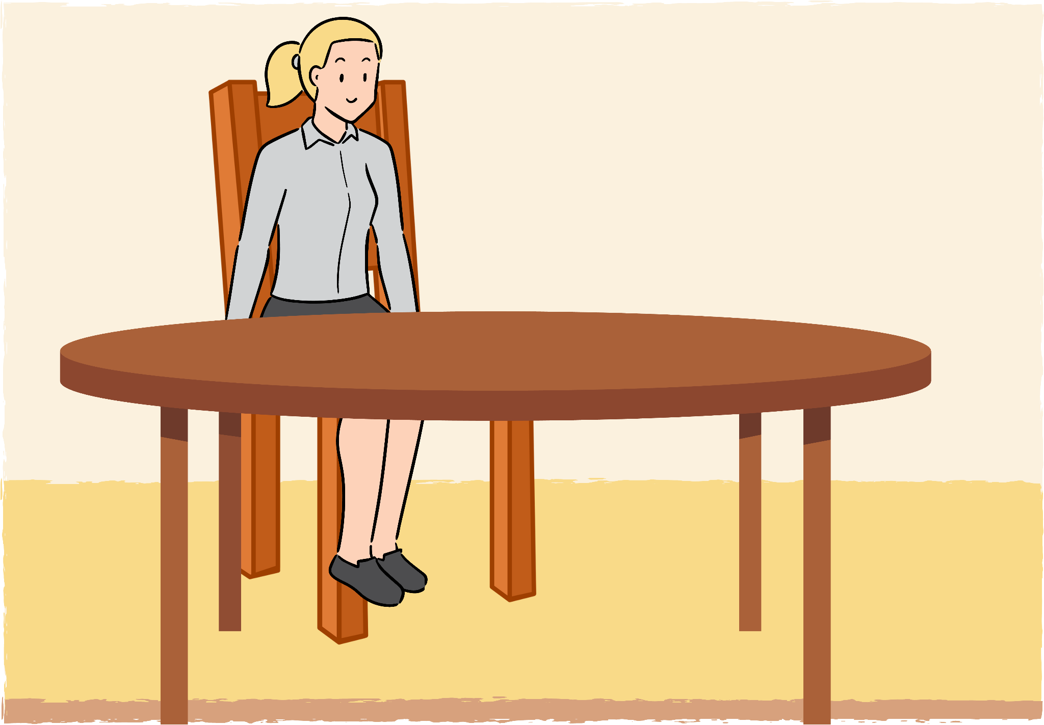
Scene #11
Medium shot of me sitting at the table, wrapping up the story structure section.
Script: “So, I walked us through a classic story structure and the a bit of the Three Acts structure (beginning, middle, and end). But there are so many cool variations. There’s the Seven Points Structure, the Save the Cat Structure, the Hero’s Journey, all of which can also fit Harry Potter. It can be so much easier to write your story when you have some architecture to build on.”
Background music: Background music continues softly.

Slide 15
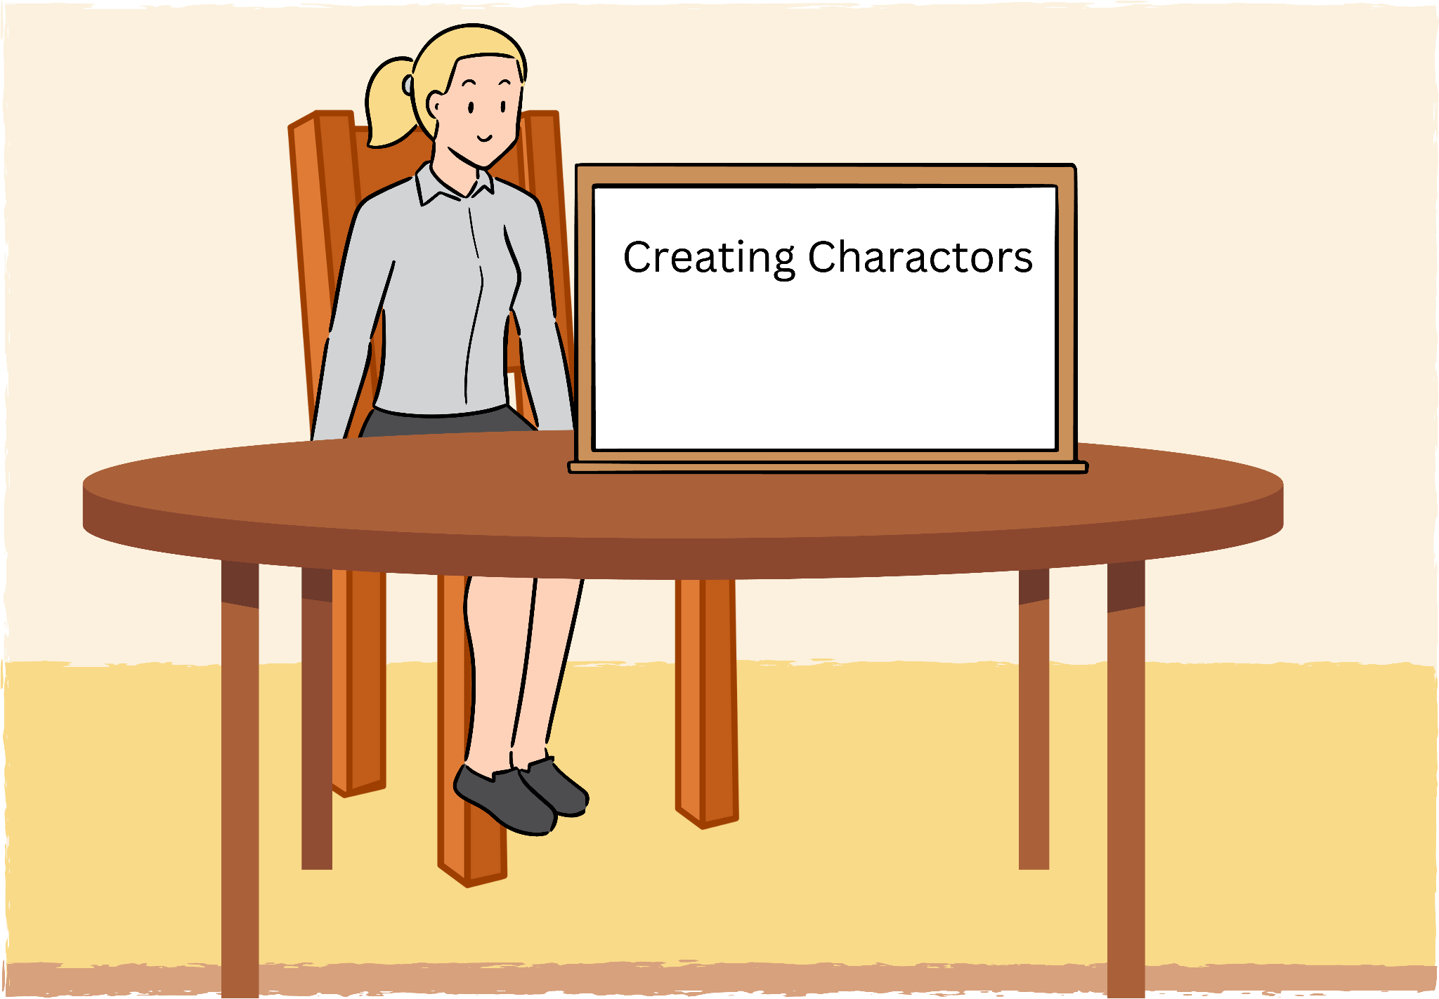
Scene #12
Medium shot of me sitting at the table and holding up white board, starting the new section: Creating Characters.
Script: “Now, to me, this is the most fun part. How do you create realistic, three-dimensional, compelling characters? It’s not an easy task, but it’s worthwhile, because usually the most emotional, impactful, and thematic parts of the story are captured within the characters.”
Background music: Background music changes to a light and lively song.

Slide 16



Scene #13
Close-up of a plain stick figure drawing. Transitions to dollar bills being pushed over in exchange for food, then my hand waving a fake wand. Transitions to drawings of a sad face and angry face.
Script: “All right. So, we’re starting from scratch here. In my opinion, the ultimate key to an engaging character is that they must want something. They can want to buy food, they can want to take over the world with magic, but they need to want something in every single scene. It can be more intangible, like they want to feel better mentally, or concrete, like they want to get revenge on a particular person.”
Background music: Background music continues as a light and lively song.

Slide 17
Scene #14
Medium close-up of me at the table.
Script: “Now, it’s not as easy as the character just wanting something and then getting it. They need goals, but they also need obstacles and conflicts and stakes. What might happen if to them or those around them if they don’t achieve their goal? What might happen if they do achieve their goal? And maybe wants and needs conflict. They think they know what they want to make them happy, but it’s not what they really need. Maybe they want fame, but they need love.”
Background music: Background music continues as a light and lively song.

Slide 18
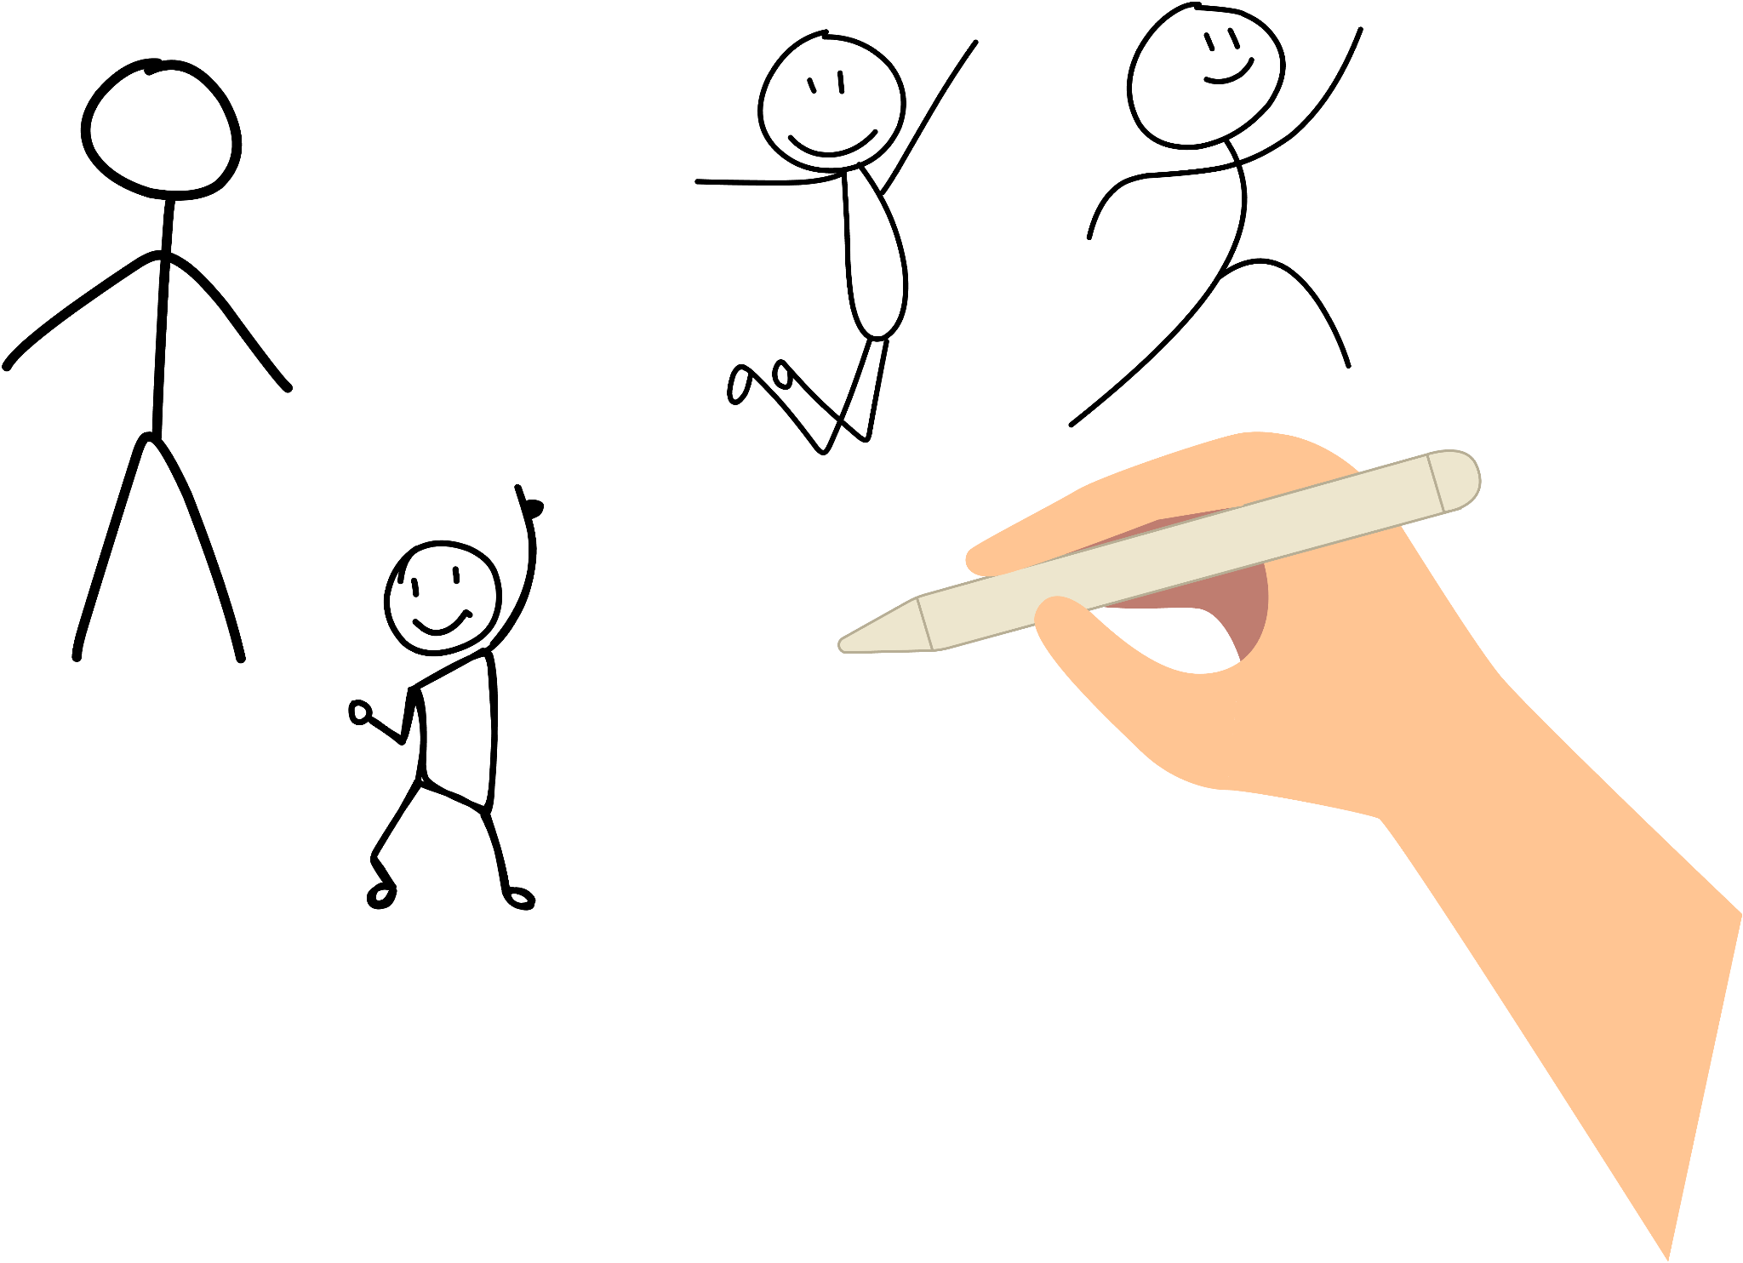
Scene #15
Close-up at various angles of myself drawing characters with different expressions and poses.
Script: “Characters should have distinct voices from each other–slang, phrasing, humor–just like real people. You’ll want to reveal background information slowly, not in a huge dump, kind of like how you might learn more about a new friend gradually. You can start brainstorming personality traits in some sort of mind map, perhaps, filling it with positives and negatives, complementary and contradictory characteristics, just like real-like messy people. Maybe someone is incredibly bright, but incredibly arrogant. Or maybe they’re kind and easy-going, but passive and indecisive. Maybe they want to be loved, but dislike other people.
And their appearance might not be important, or it might be very
important. But what about their physicality? The way they exist in their bodies? What gestures do they make? Nervous ticks? What do they do when they lie to someone? Is their gait confident, like they can take on the world, or uncertain, like they feel as if they don’t belong?”
Background music: Background music continues as a light and lively song.

Slide 19
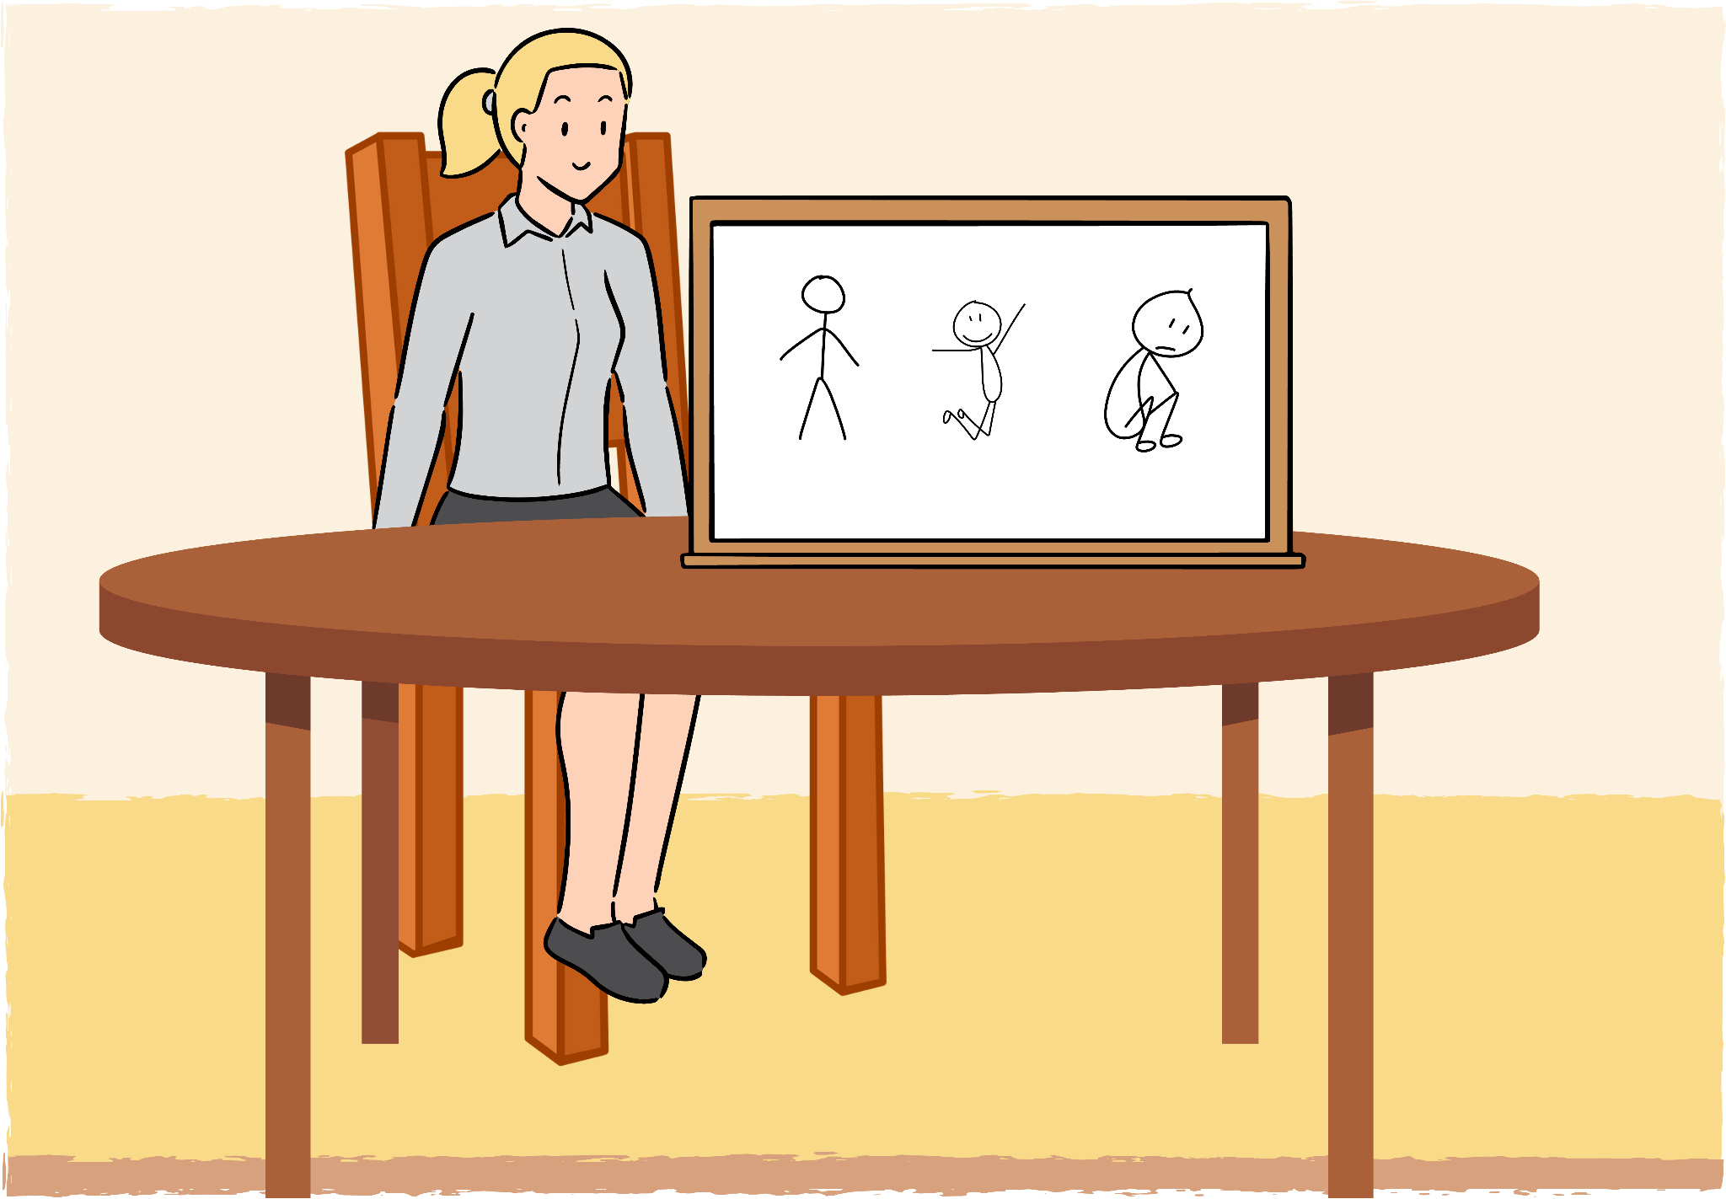
Scene #16
Medium close-up of me at the table, with the whiteboard next to me with various stick figures drawn on it (antagonists and side characters).
Script: “Creating conflict is one of the best ways to develop a character. So, you’ll develop an antagonist, with their own motivations and obstacles. And this antagonist will challenge the protagonist, test their morals, push at their resolve. Similarly, other secondary characters can allow for some contrast or foils, highlighting each other’s strengths and weaknesses.”
Background music: Background music continues as a light and lively song.

Slide 20
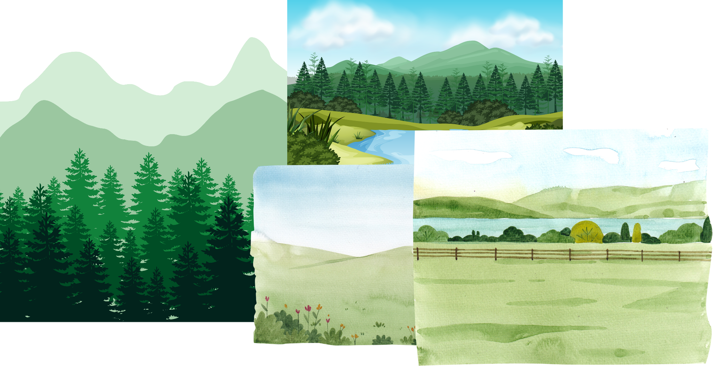
Scene #17
Various long panning shots of the outside–quite literally the “world” around me.
Script: “Now, worldbuilding. I’m going to delve into this briefly, which is a bit ironic considering how vast the concept is, but we’re all writers and enjoy irony. Anywho, one major facet of worldbuilding, which is probably most relevant in fantasy and sci-fi genres, is deciding where your character belongs in this world. Are they a local or native, and both understand and accept and live in the world near them? Are they a visitor or tourist, and everything is new and confusing, which provides a great opportunity to introduce details and conflicts to the reader? Or are they a conquerer or colonizer, where they see the world as theirs, and the people beneath them?
“Is your setting realistic? Is the internal logic consistent–for example, maybe a character mouths off to a king and is imprisoned, while later another character does the same thing and nothing happens? Or perhaps there is consistent inconsistency, where the royal family is fickle and mercurial. Do events have cause-and-effect relationships, just like our own history? Is there just one language, religion, culture–or is there a wealth of diversity and life?”
Background music: Background music continues as a light and lively song.

Slide 21
Scene #18
Medium close-up of me at the table, my laptop nearby.
Script: “I’m going to end off here for today, because by making this video, I’ve procrastinated in my own writing. Now come on, let’s get started!”
Background music: Background music continues as a light and lively song.

